Slide 1
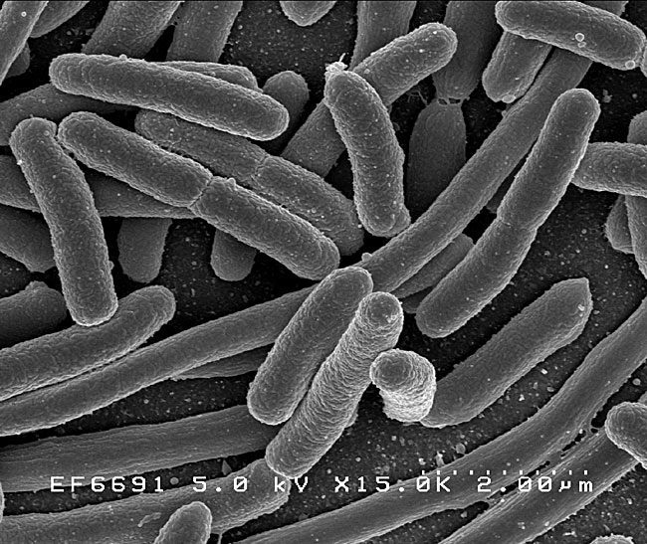
Interpreting culture and sensitivity data What the %@&$ does this MIC mean???
Jennifer Garcia, DVM, DACVIM

Slide 2
Why should we culture?
Is there a bacterial infection there to begin with?
What bacteria is it and what should I use to treat it?
Have I successfully treated the infection?
To recognize and address antimicrobial resistance

Slide 3
Clinical and Laboratory Standards Institute (CLSI)
Provides standardized guidelines for lab quality
Quality control procedures, culture methods
Publishes guidelines for the methods of susceptibility testing and the interpretive criteria for each drug
Drug manufacturers must submit the appropriate data to CLSI for determination of interpretive data, so not all drugs will have MIC info. If the drug company has not pursued validation, then the drug will not be available for microbiological testing.

Slide 4
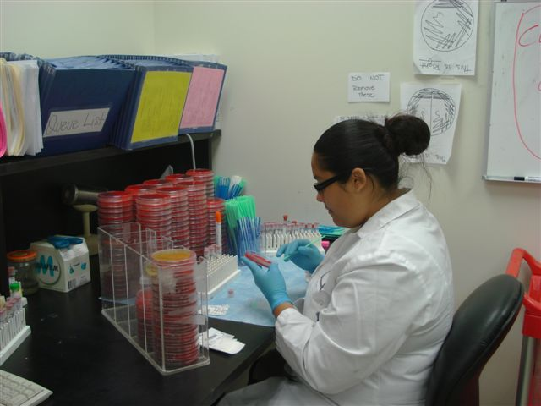
Types of bacterial cultures
Disk diffusion method (Kirby Bauer)
Agar streaked with known amount of cultured organism
Disks impregnated with known amount of drug that diffuses into the agar at a known rate.
Size of the zone around
the disk determines if
sensitive or resistant based
on CSLI standards.
Drawbacks:
Semiquantitative only
Only good for rapidly growing,
aerobic organisms

Slide 5
Types of bacterial cultures
Tube dilution method
Provides quantitative data regarding the amount of drug needed to inhibit bacterial growth
Tubes of liquid media with increasing concentration of drug are inoculated with a known amount of infecting organism
Tubes are observed for growth over a standard period of time (24-48hours)
Tube with the lowest concentration of drug at which there is no visible bacterial growth = minimum inhibitory concentration (MIC)

Slide 6
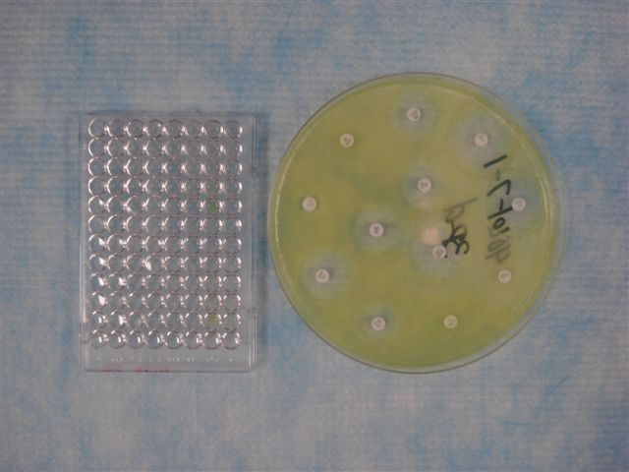
MIC = lowest concentration of antibiotic that inhibits bacterial growth

Slide 7
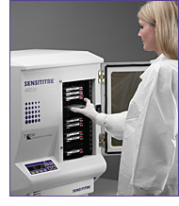

Slide 8
MIC
In order to be effective, the drug you choose needs to reach this Minimum Inhibitory Concentration at the site of the infection.
Pharmacokinetics of the drug
Toxicity
Host factors
“breakpoint MIC” – takes into account the clinical pharmacology of the drug as well as the susceptibility of the organism = approximation of drug concentration that can be safely achieved using std dose and route.

Slide 9
Breakpoint MIC
This is established by the CSLI
‘susceptible’ breakpoint = below this level the organism is considered susceptible to that drug
‘resistant’ breakpoint = above this level the organism is considered resistant to this drug.
The grey zone in between may be considered intermediate
This may be overcome depending on site of infection and drug in question.
Breakpoints will be different for different bacteria

Slide 10
Source: Urine E.col >100,000 cfu
Drug | MIC | MIC breakpoints | Interpretation
Amikacin | <=8 | 8-64 ug/ml | S
Clavamox | <=4 | 4-32 ug/ml | S
Ampicillin/amox | 2 | 0.25-32 ug/ml | S
Cefpodoxime | <=2 | 2-8 ug/ml | S
Cephalexin/cefadroxil | <=4 | 4-32 ug/ml | S
Enrofloxacin | <=0.50 | 0.5 – 4 ug/ml | S
Marbofloxacin | <=0.50 | 0.5 4 ug/ml | S
Nitrofurantoin | <=16 | 16-128 ug/ml | S
Tetracycline | <=2 | 2-16 ug/ml | S
Ticarcillin | <=16 | 16-128 ugml | S
Trimethoprim/sulfa | <=0.50 | 0.5-4 ug/ml | S

Slide 11
Urine – e. coli >100,000 cfu
Drug | MIC | MIC breakpoints | Interpretation
Amikacin | <=8 | 8-64 ug/ml | R
Clavamox | >=32 | 4-32 ug/ml | R
Ampicilin/ Amoxicilin | >=8 | 0.25-32 ug/ml | R
Cefpodoxime | >=8 | 2-8 ug/ml | R
Cephalexin/Cefadroxil | >=32 | 4-32 ug/ml | R
Enrofloxacin | >4 | 0.5-4 ug/ml | R
Marbofloxacin | >4 | 0.5-4 ug/ml | R
Nitrofurantoin | 32 | 16-128 ug/ml | S
Tetracycline | >16 | 2-16 ug/ml | R
Ticarcilin | >=128 | 16-128 ug/ml | R
Trimethoprim/ Sulfa | >2 | 0.5-4 ug/ml | R

Slide 12
Extended sensitivity panel
Cefixime R (Suprax-3rd gen, PO)
Cefotaxime R (Claforan-3rd gen, IV)
Cefoperazone R (Cefobid,3rd gen, IV)
Ceftiofur R (Naxcel, 3rd gen IV)
Cefoxitin R (2nd gen, IV)
Ceftazidime R (Fortaz, 3rd gen, IV)
Ciprofloxacin S (PO)
Imipenem S (IV)
Meropenum S (IV, SC)
Ticarcillin R (IV, IM)
Timentin R (IV, IM)

Slide 13
Urine: Pseudomonas >100,000 cfu
Drug | MIC | MIC breakpoints | Interpretation
Amikacin | <=8 | 8-64 ug/ml | S
Clavamox | N/A | --- | ---
Ampicillin/ Amox | N/A | --- | ---
Cefpodoxime | >=8 | 2-8 ug/ml | R
Cephalexin | N/A | --- | ---
Enrofloxacin | >=4 | 0.5-4 ug/ml | R
Marbofloxacin | 1 | 0.5-4 ug/ml | S
Nitrofurantoin | >128 | 16-128 ug/ml | R
Tetracycline | >=16 | 2-16 ug/ml | R
Ticarcillin | 32 | 16-128 ug/ml | S
TMS | N/A | --- | ---

Slide 14
Caveats
In vitro ≠ in vivo
Susceptibility to a drug within a class does not always correspond to susceptibility to all drugs in that class
Sensitivity tests are assessed based on plasma levels and may not predict tissue concentrations
i.e. may be able to overcome resistance via topical application
Do not take into account local factors such as pus, necrosis, poor perfusion, etc
For human drugs, MIC data is based on human pharmacokinetics

Slide 15
So how do I choose a drug based on the MIC?
Consider the body system you are treating
Renally excreted drugs best for kidney infections
Drugs that concentrate in WBC’s for pneumonia
Pick one that is the farthest from the lowest end of the breakpoint range.
If similar susceptibility, consider breadth of spectrum, toxicity and ease of administration

Slide 16
Renal elimination = increase urine concentration:
Penicillins
Cephalosporins
Tetracyclines (NOT doxy)
Fluorquinolones
Aminoglycosides
TMS

Slide 17
urine concentration of common drugs
Drug Dose Route [urine] (mg/kg) Amikacin 5 SC 342 (±143) Amoxicillin 11 Oral 202 (±93) Ampicillin 26 Oral 309 (±55) Cephalexin 18 Oral 500 Chloramph 33 Oral 123.8 (±39.7) Enrofloxacin 5 Oral 40 (±10) Gentamicin 2 SC 107.4 (±33.0) Nitrofurantoin 4.4 Oral 100 Tetracycline 18 Oral 137.9 (±64.6) TMS 13 Oral 55.0 (±19.2)

Slide 18
Methicillin Resistance
Not all staph with methicillin resistance are cause for panic
Our biggest worry is with MRS-aureus (MRSA)
MRS-pseudintermedius
Pseudintermedius normal canine flora but CAN be an opportunistic pathogen in dogs
Transmittable to humans but low incidence
Scary thing is the rise in resistance we are beginning to see with pseud. (15% of skin cultures!)

Slide 19
MRSA
S. aureus is a common commensal in people so… dogs can get it from people and become colonized
Carry it in the nose and GIT
Limit nose to mouth contact (no licking!)
Resistance usually seen in cases where there has been previous abx use
3.8 x more likely to have MRSA if abx used within the last 90 days
4.6 x more likely if that abx was a fluorquinilone **
Colonization is usually transient so once people are tx, dog will usually self-clear within 2-4 weeks unless re-infected.
There is no data that we can successfully decolonize these dogs with antibiotic therapy so tx of aysmptomatic dogs is not indicated and may just lead to increased resistance.
**Methicillin-Resistant and -Susceptible Staphylococcus aureus Infections in Dogs
Meredith C. Faires, Michelle Traverse, Kathy C. Tater, David L Pearl, and J. Scott Weese
Emerging Infectious Diseases • www.cdc.gov/eid • Vol. 16, No. 1, January 2010

Slide 20
Concerns about mrsa
Is My Pet The Source Of My MRSA Infection?
Pets can be carriers of MRSA, especially in households where people are repeatedly found to have MRSA infections, but this does not mean they are the source.
Pets are often “innocent bystanders” that acquire the MRSA from their owners.
If household infection control measures fail to control transmission of MRSA between people, AND there is evidence that a pet may be a source of MRSA, temporarily removing the pet from the household can be considered (but is rarely necessary). This should allow the pet to naturally eliminate MRSA colonization while the human members of the household undergo decolonization. Permanent removal of pets is not indicated.

Slide 21
Treatment options
Prevention is best strategy
Minimize contact with open wounds, draining pustules
Wear gloves!
Keep wounds covered
Keep toys and bedding clean (daily)
Hand washing between patients
Culture all dermal infections if
expect protracted treatment

Slide 22
Treatment options
Antibiotics
Chloramphenicol and amikacin are the only drugs that have retained sensitivity
Maybe TMS and doxy
No good options on the horizon
Good news is that systemic infections in dog with MRSA are rare

Slide 23
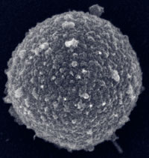
Resource for mrsa info
http://www.wormsandgermsblog.com/promo/services/

